Slide 1
SI Youth Librarians’ Conference – Timaru
Code Red: pilot project in seven NZ libraries
Annette Beattie @huttcity.govt.nz
Manager Digital Strategy and Business Development – Hutt City Council (Libraries)
library.huttcity.govt.nz
twitter.com/huttcitylibs

Slide 2
Getting off the grass
Becoming a knowledge economy
Global skills, global competiveness
MBIE fund – Sir Paul Callaghan
library.huttcity.govt.nz
twitter.com/huttcitylibs
Notes:
Big picture context

Slide 3
What’s this got to do with libraries?

Slide 4
MBIE funded pilot – Code Red
Collaboration between Public Libraries NZ, Gamefroot, NZCER, Hutt City Libraries + Dunedin, Timaru, Nelson, Porirua, Wellington & Gisborne libraries
10-18 year olds and teachers in these communities
Sept 2015 – Feb 2016
Game programming using Gamefroot a game creator developed on HTML5 and Blockly by Wellington company GameLab.

Slide 5
Learning outcomes
Basic coding and computing principles (data, variables, lists, coordinates, logical operators, control flow, functions and parameters, objects and instances, artificial intelligence); game design principles and concepts (sprites, sounds, animations); practice these concepts through making a game (making a level, placing a character, terrain, NPC characters, adding score and game over states); and launch their game in the Google Chrome Store (creating a revenue stream for themselves).

Slide 6
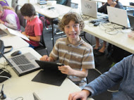
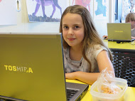
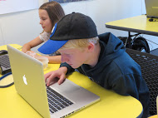
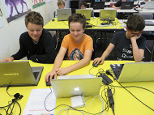

Slide 7
What did we achieve?
426 participants took part in workshops. Nearly 80 percent of participants were under 18 years of age.
363 people (76 adults and 278 young people) completed the voluntary workshop evaluation survey

Slide 8
What did we achieve…cont’d
56% never made a game previously
36% never coded previously
92% learned a lot
88% will recommend a workshop to a friend
79% now see how maths, coding and game design link

Slide 9
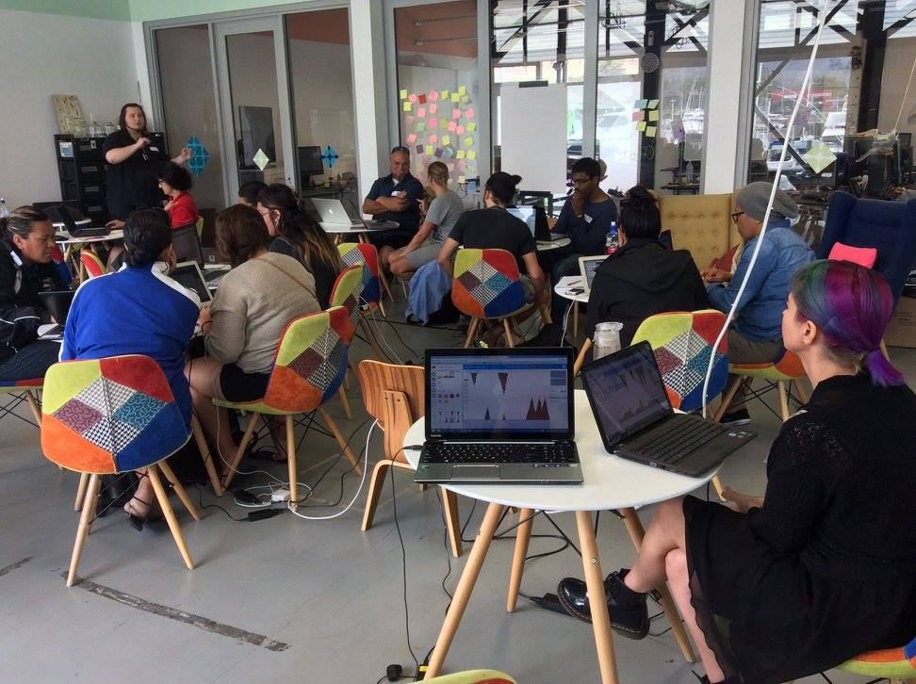
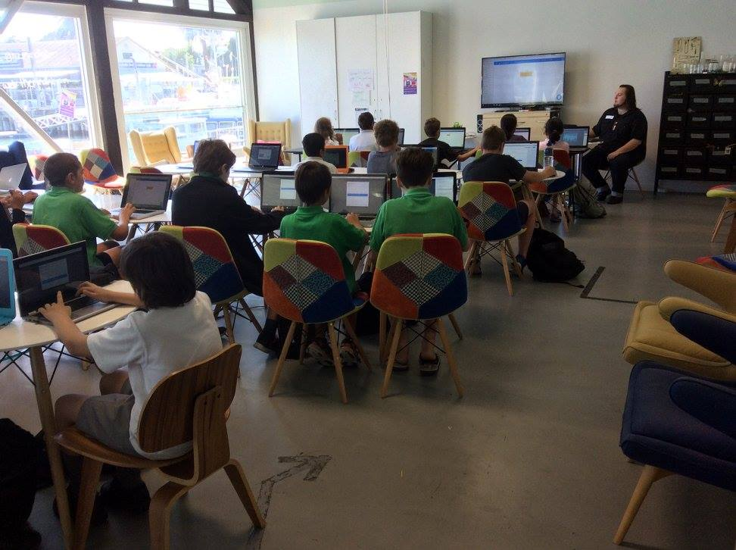
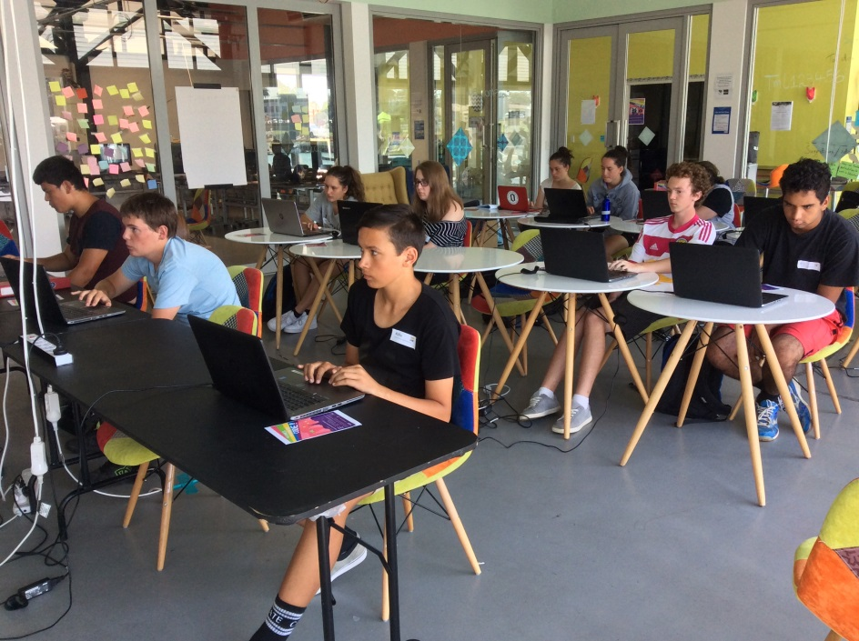

Slide 10
What did we achieve…cont’d
90% reckon public libraries are a good place to run workshops about coding/programming
83% said the workshop boosted their interest in a possible game design / coding / programming career
60% of adults said they intended to apply their new knowledge in their work with young people

Slide 11
Feedback from participants
This is a great way to enter a sometimes intimidating area of learning. (Adult participant)
A huge thanks to the reps from Public Libraries New Zealand …they too CAN make digital games and that they don't have to be JUST the players of someone else creations. (Tumuaki of Kura Kaupapa Māori)

Slide 12
So …what did we learn?
School holidays
Media
Promotion
Registration
Venues + Gear
Collaboration
Engagement

Slide 13
And now???
Application in for a Code Red #2 funding …and …
A bid for funding – robotics, coding, 3D and VR: 1500 people, 48 librarians
Fingers and toes crossed…

Slide 14
any questions? ☺

