Slide 1
Selfies in the library
Using social media to engage, inspire and inform

Slide 2
“Social media can do something no other medium can: directly engage and connect our patrons-to the library and to each other”
-Laura Solomon

Slide 3
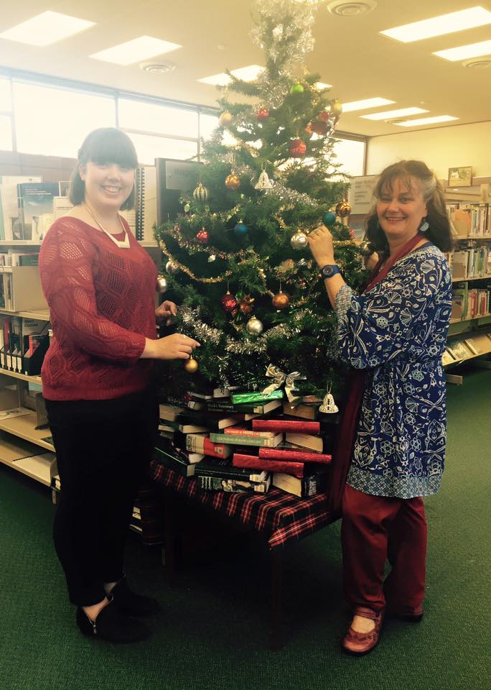

Slide 4
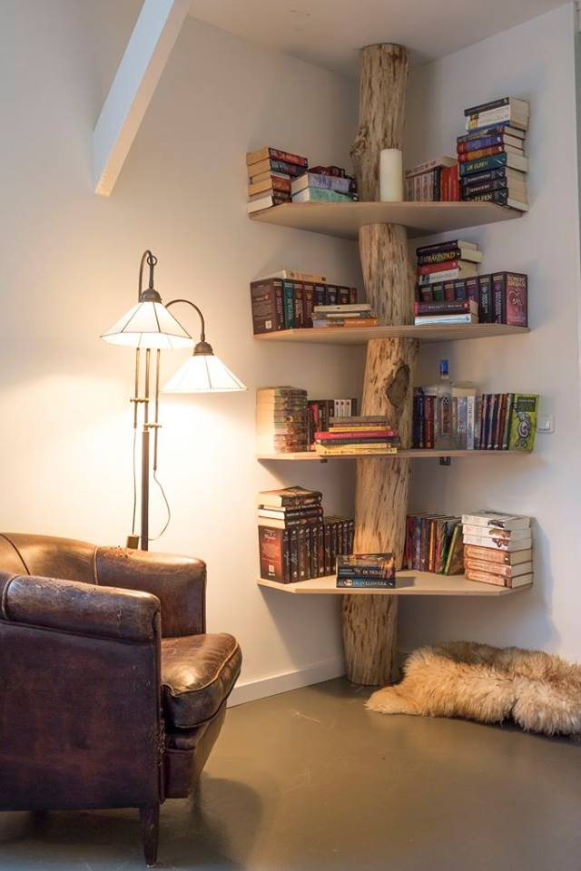

Slide 5
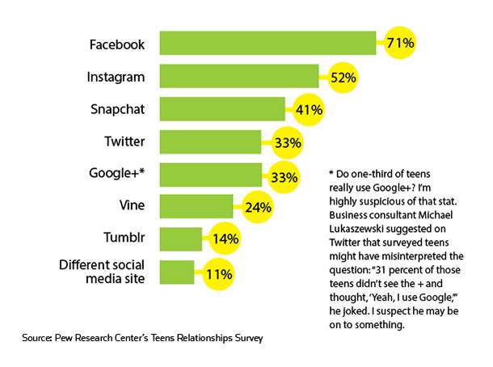
Percentage of 13-17 year olds who use..

Slide 7
Follow us
Facebook: https://www.facebook.com/WaitakiDistrictLibraries/
Twitter: @WDLibraries
Pinterest: https://www.pinterest.com/WaitakiLibrary/
Blog: https://culturewaitaki.org.nz/waitaki-district-libraries/blog

Slide 8
Find me
Twitter: @JuliadeRuiter
Blog: www.happydayslibrarian.wordpress.com
Email: jderuiter@waitaki.govt.nz

